Slide 1
RFocus: Beamforming Using Thousands of Passive Antennas
Venkat Arun and Hari Balakrishnan
MIT, CSAIL

Slide 2
Goal: Increase Signal Strength
Cellular Networks ⎜WiFi ⎜IoT Sensor Networks

Slide 3
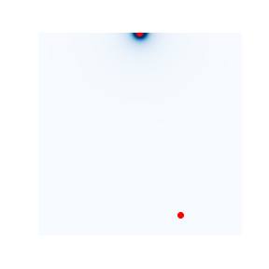
Transmitter
1 Antenna
Receiver

Slide 4
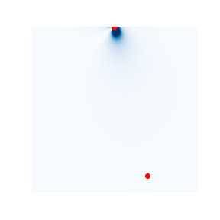
Transmitter
4 Antennas
Receiver

Slide 5
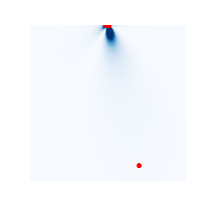
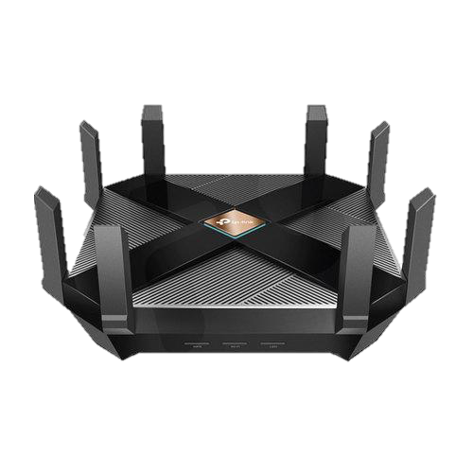
Transmitter
9 Antennas
Receiver

Slide 6
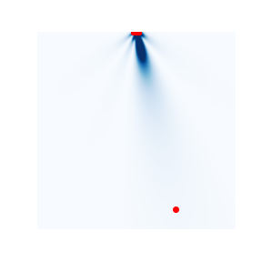
Transmitter
25 Antennas
Receiver

Slide 7
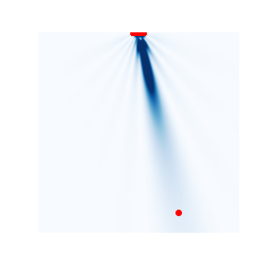
Transmitter
100 Antennas
Receiver

Slide 8
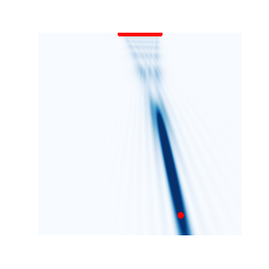
Transmitter
1024 Antennas
Receiver

Slide 9
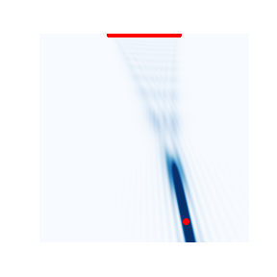
Transmitter
3136 Antennas
Receiver

Slide 10



1 Antenna
100 Antennas
3136 Antennas
Beamforming ability is a function of the
number of wavelengths the device spans
Bigger the array, more precise the beam
This is a fundamental physical limit!

Slide 11
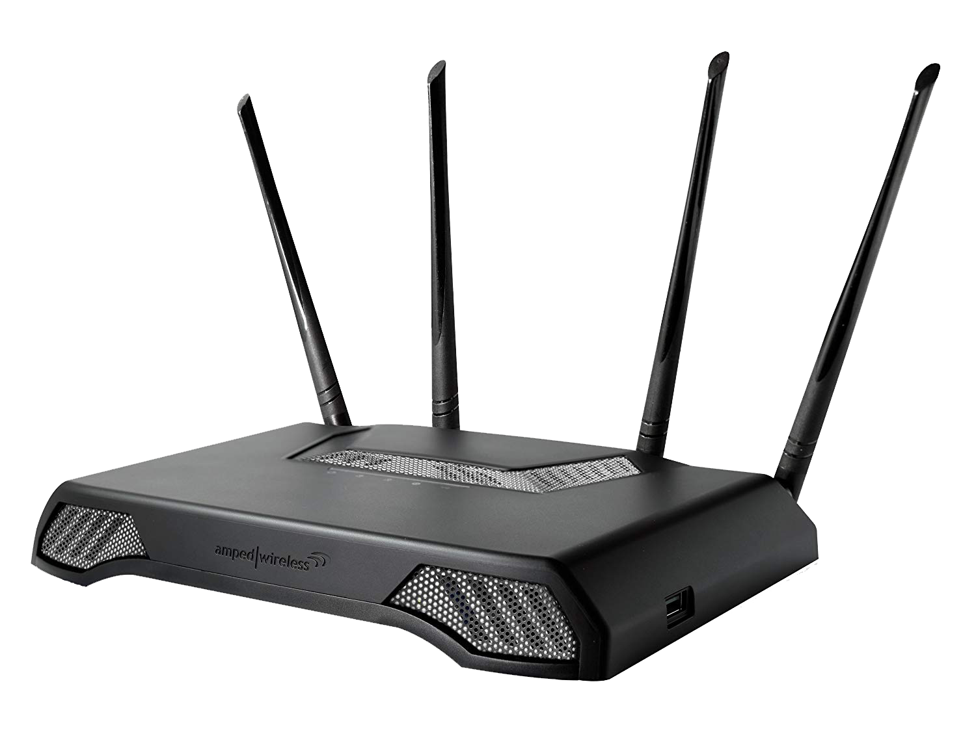
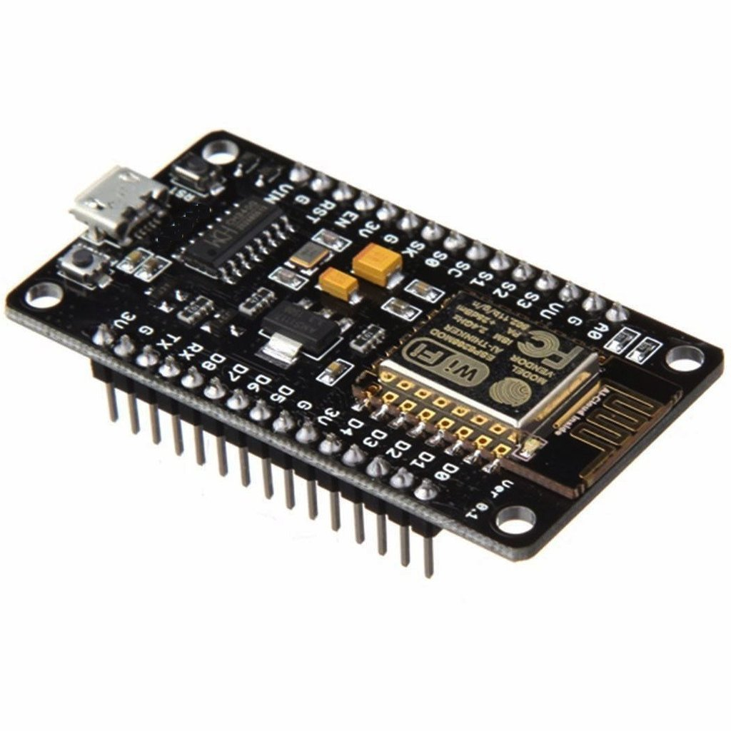


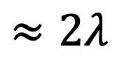
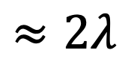
< 10 Antennas
$$≈2λ$$
$$≈2λ$$

Slide 12
The environment is already big. Let’s put antennas there!
More antennas won’t fit in our devices

Slide 13
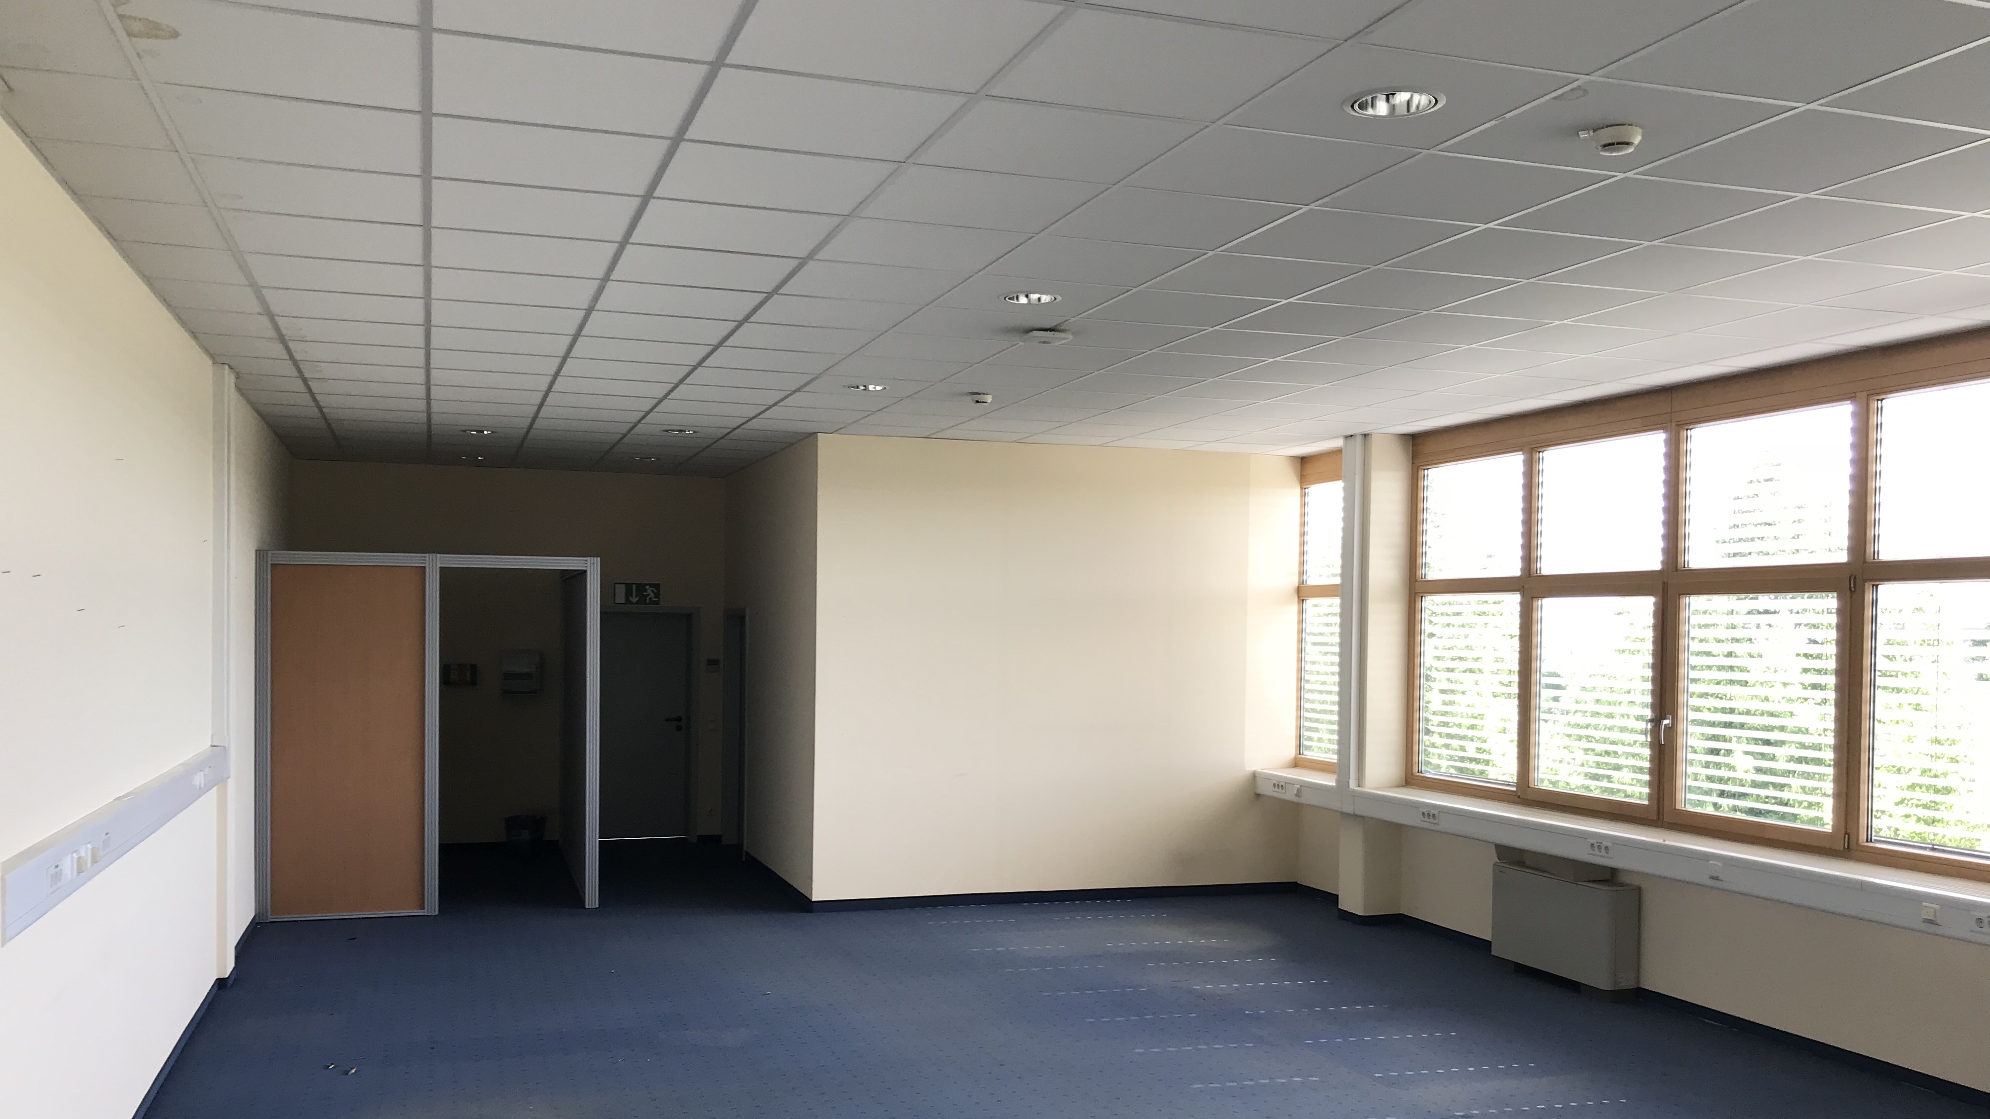
Ceiling
Walls
Carpets

Slide 14
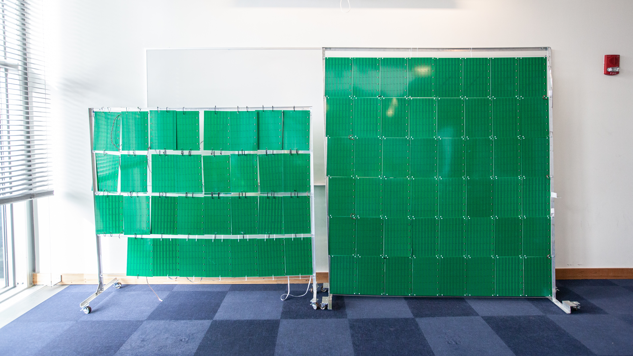
RFocus: An inexpensive “wallpaper” full of antennas
3200 antennas
On - Reflective
Off - Transparent
Passive: Does not emit any power
Only controls how it reflects radio
(like an RFID tag)

Slide 15
3200 Antennas
To our knowledge, this is the largest number of antennas ever used for a single communication link

Slide 16
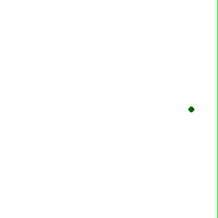

Slide 17
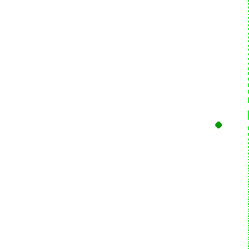
Target

Slide 18
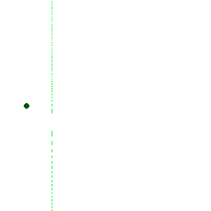
Target

Slide 19


System Architecture
RFocus surface
Periodically sends channel measurements
Receiver
RFocus Controller
Optimized state to maximize signal strength between transmitter and receiver
Configures ‘test states’ on the surface
Transmitter

Slide 20
Reflection from a wall
Rx
…
Im
h_{z}
h₅
h₆
h₆
h₃
h₅
h₄
h₄
h₂
Tx
h₃
h₁
h₂
h
h₁
h_{z}
Re

Slide 21
Improving the Reflection
Rx
RFocus allows us to make
some elements transparent
…
Im
h_{z}
h₅
h₆
h₆
h₃
h₅
h₄
h₄
h₂
Tx
h₃
h₁
h₂
h
h₁
h_{z}
Antennas in RFocus
Re

Slide 22
Improving the Reflection
Rx
RFocus allows us to make
some elements transparent
Red elements reduce strength
Let’s turn them off
…
Im
h_{z}
h₅
h₆
h₆
h₃
h₅
h₄
h₄
h₂
Tx
h₃
h₁
h₂
h
h₁
h_{z}
Re

Slide 23
Improving the Reflection
Rx
RFocus allows us to make
some elements transparent
Red elements reduce strength
Let’s turn them off
…
Im
h_{z}
h₅
h₆
h₆
h₃
h₅
h₄
h₄
h₂
Tx
h₃
h₁
h₂
h
h₁
h_{z}
By removing destructive interference,
we increase signal strength
Re

Slide 24
Which antennas should we turn off?
Im
h₅
h₆
h₃
h₄
h₂
h₁
h_{z}
Re

Slide 25
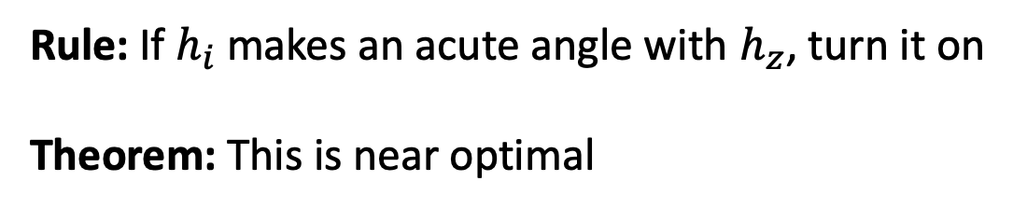
Which antennas should we turn off?
Im
Rule: If $h_{i}$ makes an acute angle with $h_{z}$, turn it on
Theorem: This is near optimal
Turn on
Turn off
h₃
h₂
h₅
h₄
h₆
h₁
h_{z}
Re

Slide 26
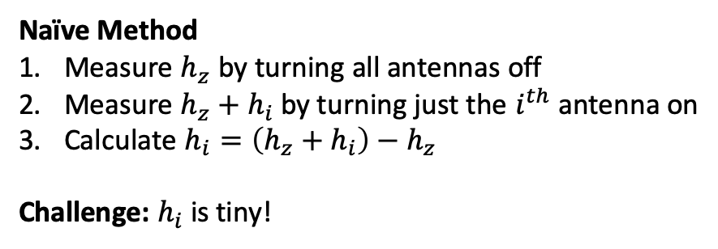
Strawman 1: Prior Work
Im
If we can measure $h_{z}$ and $h_{i}$, we can find the optimum state
Naïve Method
Measure $h_{z}$ by turning all antennas off
Measure $h_{z}+h_{i}$ by turning just the $i^{th}$ antenna on
Calculate $h_{i}=\left(h_{z}+h_{i}\right)−h_{z}$
Challenge: $h_{i}$ is tiny!
h_{i}
h_{z}
h_{z} + h_{i}
Re

Slide 27
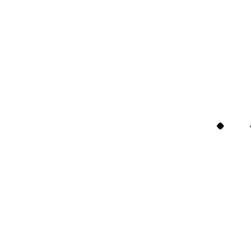
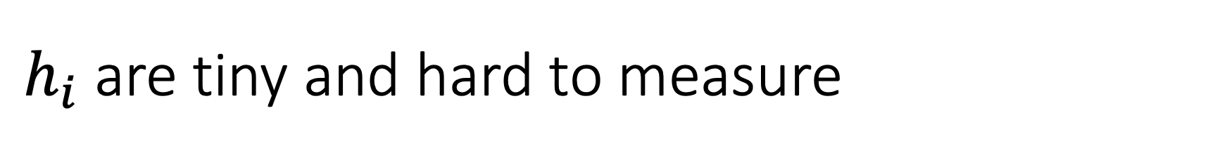
$h_{i}$ are tiny and hard to measure
Source
Tiny reflection

Slide 28
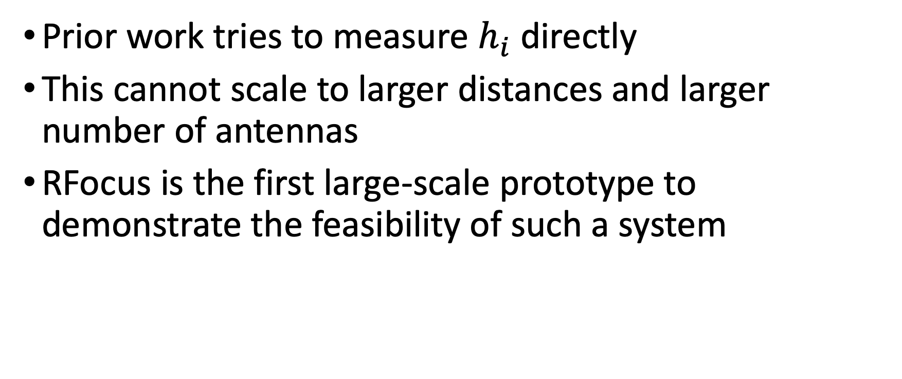
Prior work tries to measure $h_{i}$ directly
This cannot scale to larger distances and larger number of antennas
RFocus is the first large-scale prototype to demonstrate the feasibility of such a system
“Optimally diverse communication channels in disordered envi-ronments with tuned randomness”, P. del Hougne, M. Fink, and G. Lerosey
“Shaping complex microwave fields in reverberating media withbinary tunable metasurfaces”, N. Kaina, M. Dupré, G. Lerosey, and M. Fink
“Increasing indoor spectrum sharing capacity using smart reflect-array”, X. Tan, Z. Sun, J. M. Jornet, and D. Pados

Slide 29
Related Work: LAIA
Wall
Blocked
Transmitter
Receiver

Slide 30
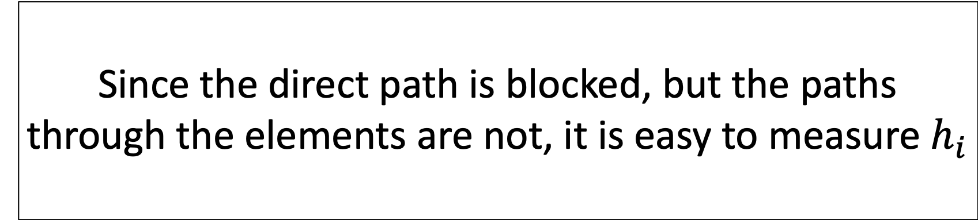
Related Work: LAIA
Only works for endpoints blocked by this wall
Wall
Since the direct path is blocked, but the paths through the elements are not, it is easy to measure $h_{i}$
Transmitter
Receiver

Slide 31
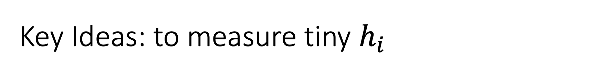
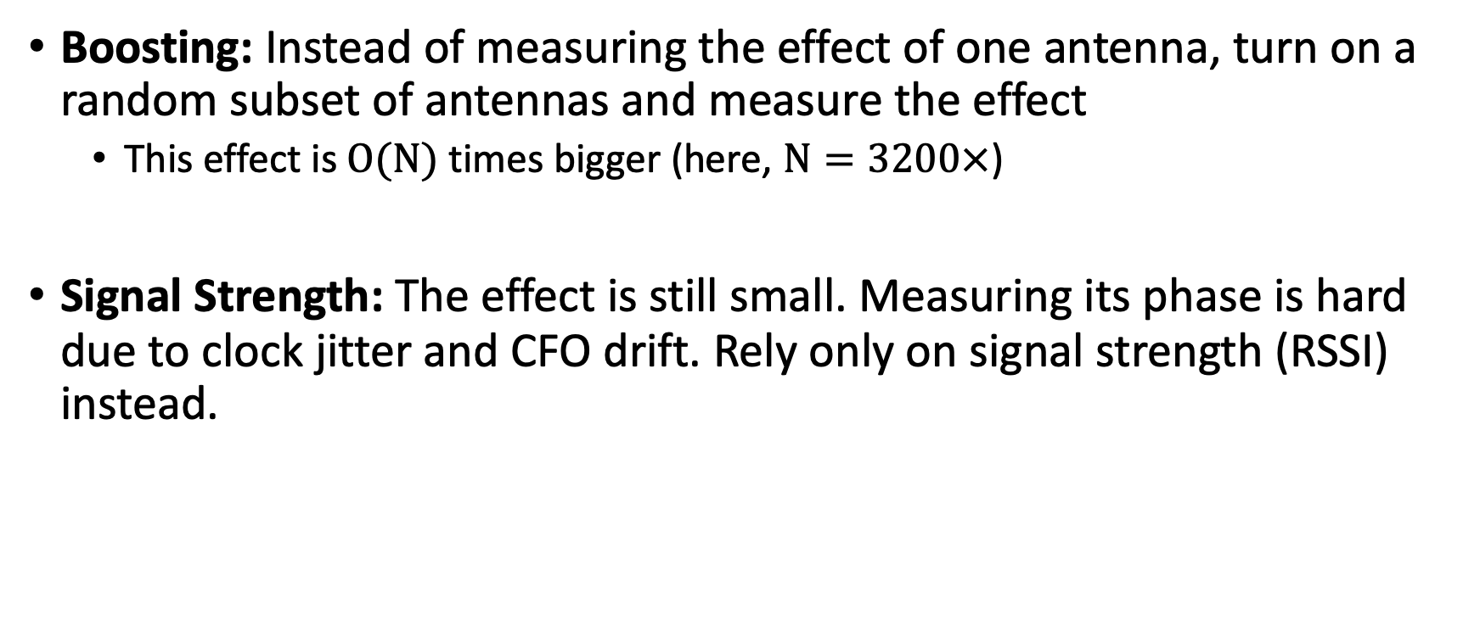
Key Ideas: to measure tiny $h_{i}$
Boosting: Instead of measuring the effect of one antenna, turn on a random subset of antennas and measure the effect
This effect is $O(N)$ times bigger (here, $N=3200×$)
Signal Strength: The effect is still small. Measuring its phase is hard due to clock jitter and CFO drift. Rely only on signal strength (RSSI) instead.

Slide 32
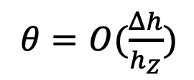
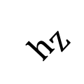
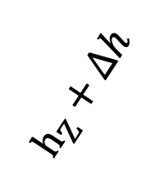
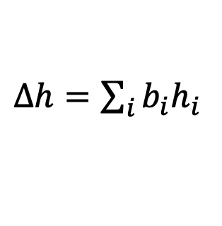
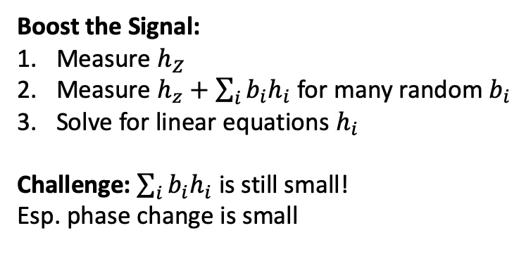
Strawman 2: Boosting
If we can measure $h_{z}$ and $h_{i}$, we can find the optimum state
Im
Boost the Signal:
Measure $h_{Z}$
Measure $h_{z}+\sum_{i}{b_{i}h_{i}}$ for many random $b_{i}$
Solve for linear equations $h_{i}$
Challenge: $\sum_{i}{b_{i}h_{i}}$ is still small!
Esp. phase change is small
$Δh=\sum_{i}{b_{i}h_{i}}$
$h_{Z}+Δh$
$h_{Z}$
$θ=O(\frac{Δh}{h_{Z}})$
small
Re

Slide 33
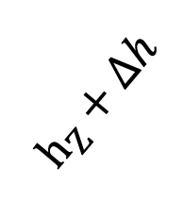
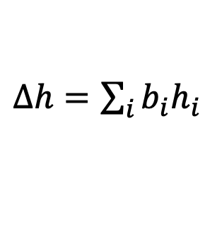
Strawman 2: Boosting
If we can measure $h_{z}$ and $h_{i}$, we can find the optimum state
Im
$Δh=\sum_{i}{b_{i}h_{i}}$
Boost the Signal:
Measure $h_{Z}$
Measure $h_{z}+\sum_{i}{b_{i}h_{i}}$ for many random $b_{i}$
Solve for linear equations $h_{i}$
Challenge: $\sum_{i}{b_{i}h_{i}}$ is still small!
Esp. phase change is small
$h_{Z}+Δh$
$h_{Z}$
grows smaller
$θ=O(\frac{Δh}{h_{Z}})$
small
Re

Slide 34
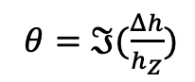
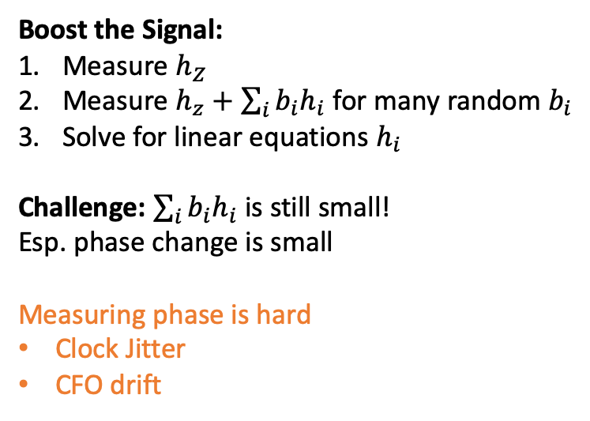
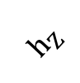
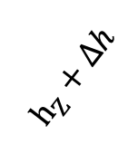
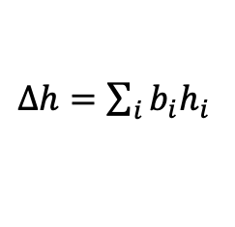
Why phase is hard to measure
Im
If we can measure $h_{z}$ and $h_{i}$, we can find the optimum state
Boost the Signal:
Measure $h_{Z}$
Measure $h_{z}+\sum_{i}{b_{i}h_{i}}$ for many random $b_{i}$
Solve for linear equations $h_{i}$
Challenge: $\sum_{i}{b_{i}h_{i}}$ is still small!
Esp. phase change is small
Measuring phase is hard
Clock Jitter
CFO drift
$Δh=\sum_{i}{b_{i}h_{i}}$
$h_{Z}+Δh$
$h_{Z}$
grows smaller
$θ=ℑ(\frac{Δh}{h_{Z}})$
small
Re

Slide 35
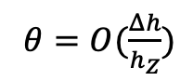
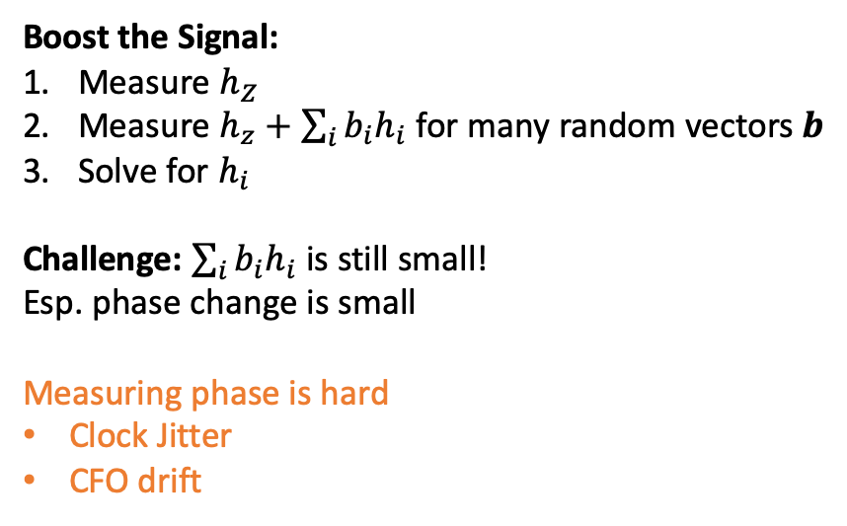
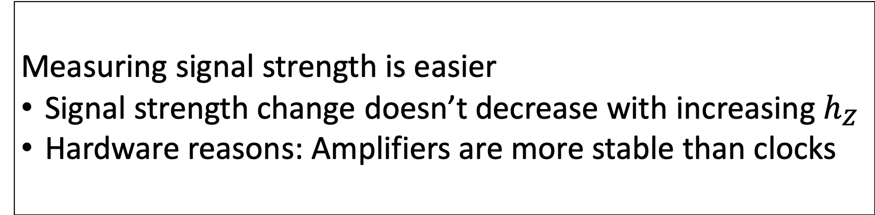
Signal Boosting
Im
If we can measure $h_{z}$ and $h_{i}$, we can find the optimum state
Measuring signal strength is easier
Signal strength change doesn’t decrease with increasing $h_{Z}$
Hardware reasons: Amplifiers are more stable than clocks
Boost the Signal:
Measure $h_{Z}$
Measure $h_{z}+\sum_{i}{b_{i}h_{i}}$ for many random vectors $b$
Solve for $h_{i}$
Challenge: $\sum_{i}{b_{i}h_{i}}$ is still small!
Esp. phase change is small
Measuring phase is hard
Clock Jitter
CFO drift
$Δh=\sum_{i}{b_{i}h_{i}}$
$h_{Z}+Δh$
$h_{Z}$
grows smaller
$θ=O(\frac{Δh}{h_{Z}})$
small
Re

Slide 36
How we take measurements
Antenna ID
1 | 2 | 3 | 4 | Signal strength Measurement
0 | 1 | 1 | 0 | 0.8
1 | 1 | 1 | 0 | 0.9
0 | 0 | 1 | 1 | 1
1 | 0 | 0 | 0 | 1.1
1 | 1 | 0 | 1 | 1.1

Slide 37
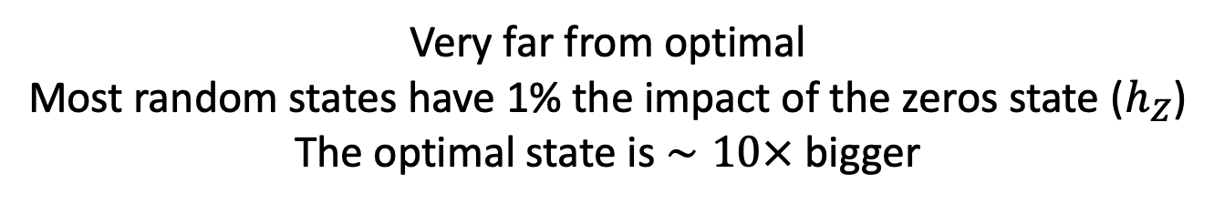
Strawman 3: Take the max of all rows
Antenna ID
1 | 2 | 3 | 4 | Signal strength Measurement
0 | 1 | 1 | 0 | 0.8
1 | 1 | 1 | 0 | 0.9
0 | 0 | 1 | 1 | 1
1 | 0 | 0 | 0 | 1.1
1 | 1 | 0 | 1 | 1.1
Very far from optimal
Most random states have 1% the impact of the zeros state ($h_{Z}$)
The optimal state is $∼10×$ bigger

Slide 38
Our Approach: Majority Voting
Antenna ID
1 | 2 | 3 | 4 | Signal strength Measurement
0 | 1 | 1 | 0 | 0.8
1 | 1 | 1 | 0 | 0.9
0 | 0 | 1 | 1 | 1
1 | 0 | 0 | 0 | 1.1
1 | 1 | 0 | 1 | 1.1
Median

Slide 39
Our Approach: Majority Voting
Antenna ID
1 | 2 | 3 | 4 | Signal strength Measurement
0 | 1 | 1 | 0 | 0.8
1 | 1 | 1 | 0 | 0.9
0 | 0 | 1 | 1 | 1
1 | 0 | 0 | 0 | 1.1
1 | 1 | 0 | 1 | 1.1
This is bad,
flip what we were doing
Median
This is good,
Keep doing the same things

Slide 40
Our Approach: How we take measurements
1 | 2 | 3 | 4 | RSSI Measurement
1 | 0 | 0 | 1 | 0.8
0 | 0 | 0 | 1 | 0.9
0 | 0 | 1 | 1 | 1
1 | 0 | 0 | 0 | 1.1
1 | 1 | 0 | 1 | 1.1
This is bad,
flip what we were doing
Median
This is good,
Keep doing the same things
Average the column
0.75 | 0.25 | 0 | 0.75

Slide 41
Our Approach: Majority Voting
Antenna ID
1 | 2 | 3 | 4 | Signal strength Measurement
01 | 10 | 10 | 01 | 0.8
10 | 10 | 10 | 01 | 0.9
0 | 0 | 1 | 1 | 1
1 | 0 | 0 | 0 | 1.1
1 | 1 | 0 | 1 | 1.1
This is bad,
flip what we were doing
Median
This is good,
Keep doing the same things
Majority Vote
1

Slide 42
Our Approach: Majority Voting
Antenna ID
1 | 2 | 3 | 4 | Signal strength Measurement
01 | 10 | 10 | 01 | 0.8
10 | 10 | 10 | 01 | 0.9
0 | 0 | 1 | 1 | 1
1 | 0 | 0 | 0 | 1.1
1 | 1 | 0 | 1 | 1.1
This is bad,
flip what we were doing
Median
This is good,
Keep doing the same things
Majority Vote
1 | 0

Slide 43
Our Approach: Majority Voting
Antenna ID
1 | 2 | 3 | 4 | Signal strength Measurement
01 | 10 | 10 | 01 | 0.8
10 | 10 | 10 | 01 | 0.9
0 | 0 | 1 | 1 | 1
1 | 0 | 0 | 0 | 1.1
1 | 1 | 0 | 1 | 1.1
This is bad,
flip what we were doing
Median
This is good,
Keep doing the same things
Majority Vote
1 | 0 | 0 | 1
Optimized State

Slide 44
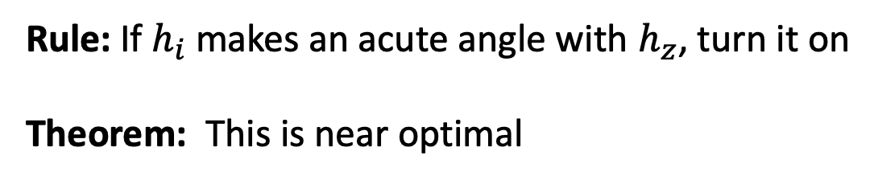
Why Majority Voting is Optimal
Im
Rule: If $h_{i}$ makes an acute angle with $h_{z}$, turn it on
Theorem: This is near optimal
Turn on
Turn off
h₂
h₃
h₅
h₄
h₁
h₆
h_{z}
Re

Slide 45
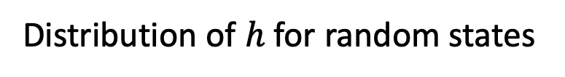
Why Majority Voting is Optimal
Im
Turn on
Effect of random states on the base channel + noise
Turn off
h_{z}
Re
Distribution of $h$ for random states

Slide 46
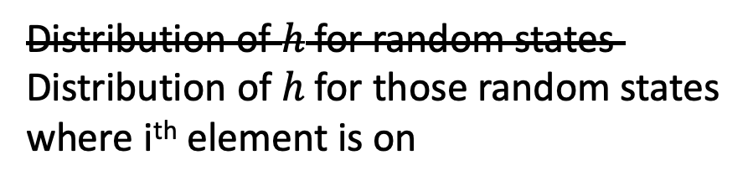
Why Majority Voting is Optimal
Im
Turn on
Effect of random states on the base channel + noise
Turn off
Effect due to element i
h_{i}
h_{z}
Distribution of $h$ for random states
Distribution of $h$ for those random states
where i^{th} element is on
Re

Slide 47
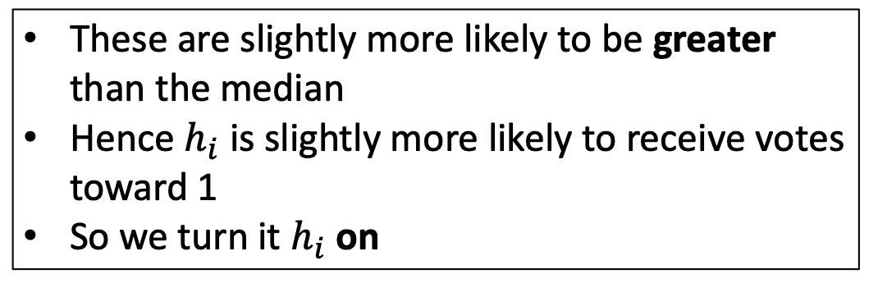
Why Majority Voting is Optimal
Im
Turn on
Effect of random states on the base channel + noise
Turn off
Effect due to element i
h_{i}
These are slightly more likely to be greater than the median
Hence $h_{i}$ is slightly more likely to receive votes toward 1
So we turn it $h_{i}$ on
h_{z}
Distribution of $h$ for random states
Distribution of $h$ for those random states
where i^{th} element is on
Re

Slide 48
How long does it take to train?
50000 Measurements
4500 Measurements
0.9
Need O(N) Measurements
1s
11s

Slide 49
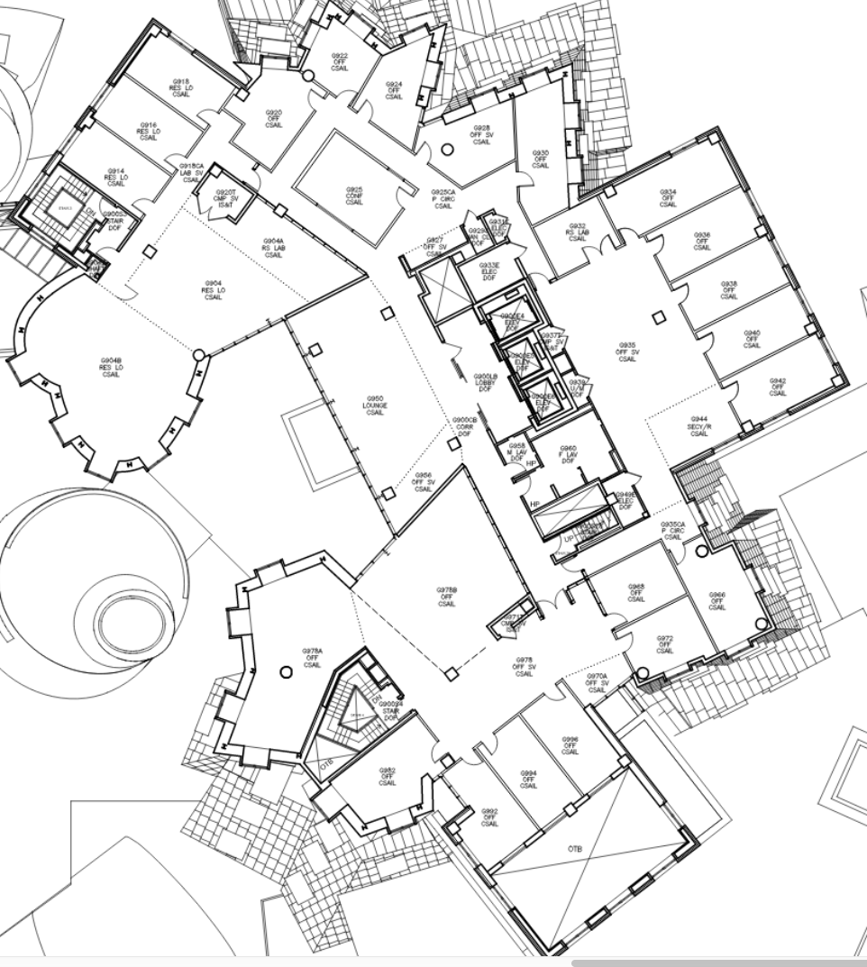

Evaluation
Scale (meters)
0 5 10
Signal Strength Improvement (dB)
Rx
RFocus Surface

Slide 50
Evaluation

Slide 51
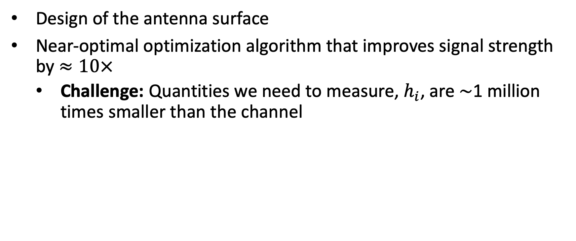
Contributions
Design of the antenna surface
Near-optimal optimization algorithm that improves signal strength by $≈10×$
Challenge: Quantities we need to measure, $h_{i}$, are $∼$1 million times smaller than the channel

Slide 52
Contact: {venkatar, hari}@csail.mit.edu
Website: https://people.csail.mit.edu/venkatar/rfocus.html

